Slide 1
Images and Hyperlinks
By: Neelam Singh

Slide 2
HTML - Images
Images are very important to beautify as well as to depict many complex concepts in simple way on your web page.
Inserting Image:
We can insert any image in a web page by using <img> tag.
Following is the simple syntax to use this tag.
<img src = "Image URL" ... Attributes-list/>
The <img> tag is an empty tag, which means that, it can contain only list of attributes and it has no closing tag.
We can use png, jpg or gif image file based on your comfort but make sure you specify correct image file name in src attribute. Image name is always case sensitive.

Slide 3
Set Image Width/Height
We can set image width and height based on our requirement using width and height attributes. We can specify width and height of the image in terms of either pixels or percentage of its actual size.
Set Image Border
By default, image will have a border around it, you can specify border thickness in terms of pixels using border attribute. A thickness of 0 means, no border around the picture.
Set Image Alignment
By default, image will align at the left side of the page, but you can use align attribute to set it in the center or right.

Slide 4

Hyperlinks
Hyperlinks are one of the most exciting innovations the Web has to offer.
They allow us to link our documents to any other document (or other resource) we want to, we can also link to specific parts of documents, and we can make apps available at a simple web address.
Just about any web content can be converted to a link, so that when clicked (or otherwise activated) it will make the web browser go to another web address (URL).
Syntax:

Slide 5
Attributes
.
:
href :
The href attribute is used to specify the destination address of the link used.
Text link
The text link is the visible part of the link.
target attribute
A target attribute ( target="" ) is used to tell window where to open that particular link.

Slide 6
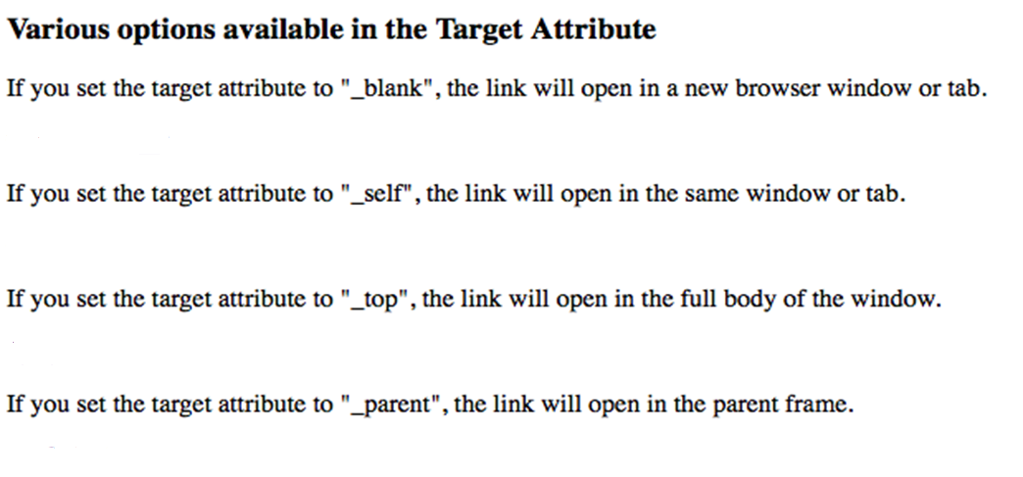

Slide 7
Internal Links
An internal link is a type of hyperlink whose target or destination is a resource, such as an image or document, on the same website or domain.
HTML internal link is linked within the same web page. This link can be an absolute path or relative path.
HTML internal link name is followed by the hash sign(#).
Page jumps are done by using the name attribute of the <a> element or by using id attribute of a tag.
For example:
<a href="#lession1">Lession.1</a> link can be referred as
<a name="lession1">Introduction of Lession.1</a> automatically.
<a href="#lession2">Lession.2</a> link can be referred as
<div id="lession2">Introduction of Lession.2</div> automatically.

Slide 8
Linking to an internal link in an external file
We use name reference as well as file name to access content in an external file which has an internal line as well.
For e.g.
Let the file is ABC.html which has an internal link with name as L1. To refer to the content we will use the <a> tag as:
<a href=“ABC.html#L1”>Click</a>

